Slide 1
PROJECT WORK
DS-PG 19

Slide 2

Welcome to UpTrack Analytics

Slide 3
About us
With a worldwide presence, UpTrack Analytics is a data analytics firm that has maintained a continuous commitment throughout its history to providing detailed inferences from all kinds of data.
For the past decades, it has been the leading data analyzing firm turning data into meaningful knowledge for clients, people, communities and the capital markets.
The industry line of business and sectors that UpTrack Analytics focuses on are as follows: Healthcare, Government, Industrial Markets and Financial services.

Slide 4
Vision
To maintain a pedigree of serviceability by helping African businesses stay competitive and relevant on the global frontier.
Mission
To empower African businesses by helping them derive meaningful business-essential insights from the data they produce.

Slide 5

Jemima E. Denteh Project Manager
Jemima provides a contact channel for customers, companies and agencies to implement their top projects. Working with both private and public agencies, she understands the peculiarity of each construction project that comes into her hands.
In her role as Project Manager, Jemima incorporates her entire team into active participation and sets clearly defined roles to ensure a timely delivery of formidable results.
Jemima is an Azubi Africa Fellow at GIBT. Her education includes University of Ghana – BSc. Actuarial Science.

Slide 6
FRANKLIN ADJEI Data Scientist
....

Slide 7
ANITA TAY Data Scientist

Slide 8

Kofi Okwan Ocran Data Scientist
Kofi is a graduate of the University of Ghana with a
Bachelor’s degree in Mathematics and Economics.
He currently works at Science Solutions Centre
where he tutors in Advanced and Ordinary Level Mathematics.
Concurrently, he is part of the Azubi Africa program and he seeks to harness his skills in the Data Science field.

Slide 9
ANALYSIS ON THE HOSPITAL FACILITY ALLOCATION PROJECT
Our client needed insight and recommendations on where to create hospitals and effectively position them based on the health facility data which covered the following headings;
Region, District, Facility Name, Type, Town, Ownership, Latitude and Latitude.

Slide 10
POLISHING THE DATA
From the data we were given, we realized some of the values were missing and if we should work with everything, it would be quite problematic
From the data, there was supposed to be 3756 values under each column but this is what we found; Town had 3603 values with 153 missing values
Latitude and Longitude had 3732 values with 24 missing values

Slide 11
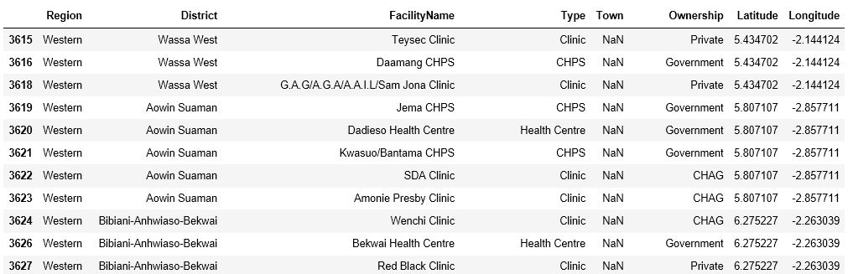
Missing Town values [Sample]

Slide 12
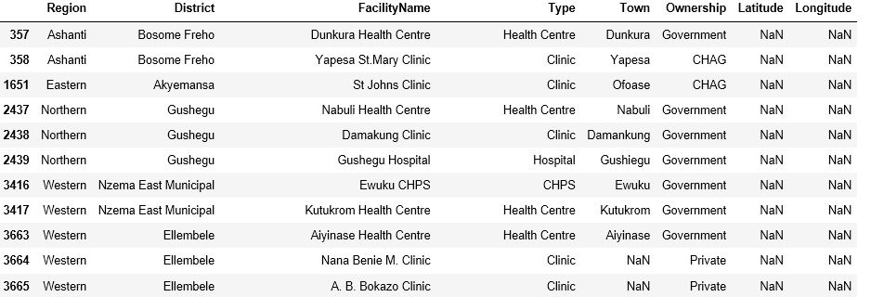
Missing Longitude and Latitude values [Sample]

Slide 13
Strategy
Owing to some of the values being missing from the data set, we decided to find out which rows had both the value for the town, longitude and latitude missing so that we could remove them.
We discovered 8 of them.

Slide 14
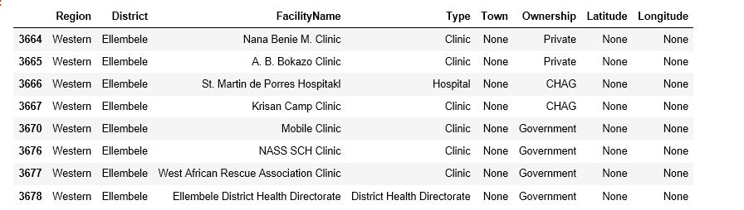

Slide 15
From the data set, we realized that the heath facility name played a vital role in knowing the number of distinct health facilities available.
That is, there is no way there could be two hospitals bearing the same name.
Having polished the data by taking out the ones with missing values out, we sorted it to know the number of health facilities available in each region.

Slide 16
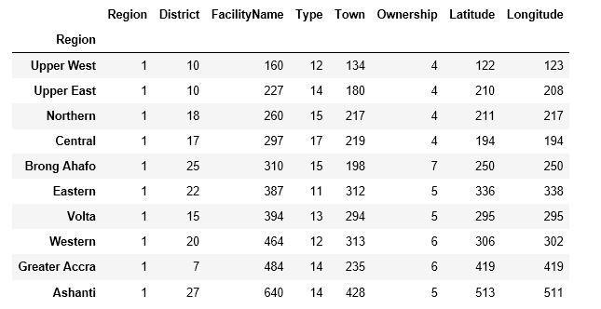

Slide 17
From this data obtained, our goal was to tackle the first four regions with least health facilities to know whether they had enough health facilities in all their towns.
These regions were; Central Region, Upper West Region, Upper East Region and Northern Region.

Slide 18
NUMBER OF TOWNS WITH A GIVEN NUMBER OF HEALTH FACILITY
NUMBER | CENTRAL REGION | NORTHERN REGION | UPPER WEST REGION | UPPER EAST REGION
1 | 189 | 184 | 119 | 151
2 | 15 | 22 | 9 | 20
3 | 6 | 7 | 3 | 4
4 | 2 | 2 | 1 | 2
5 | 3 | 2 | 1 | 1
6 | - | - | 1 | -
7 | - | - | - | 1
8 | - | - | - | -
9 | 1 | - | - | 1

Slide 19
From the information gathered from the four regions, we realized most of the towns had one hospital facility available.
To make a concrete decision on where to build these hospitals, we conducted a cumulative frequency curve to affirm the number of towns lacking heath facility per a given percentile.

Slide 20
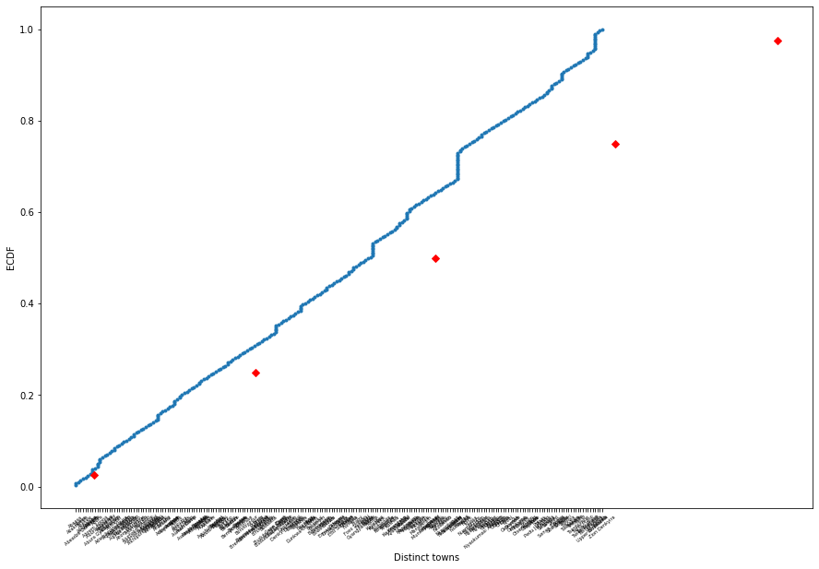
CENTRAL REGION

Slide 21
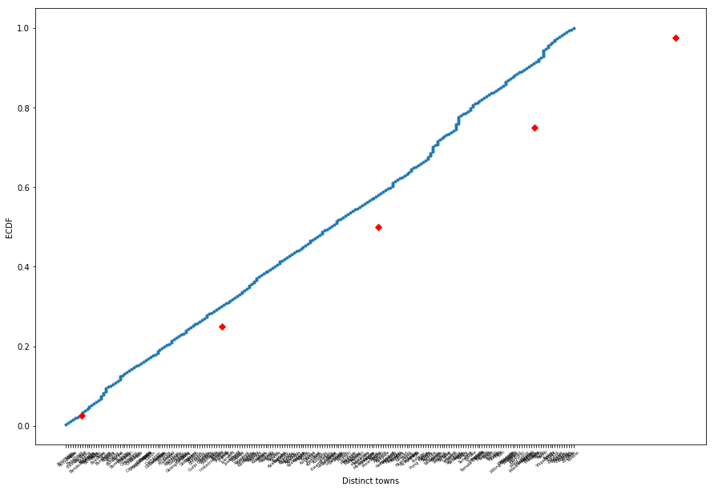
NORTHERN REGION

Slide 22
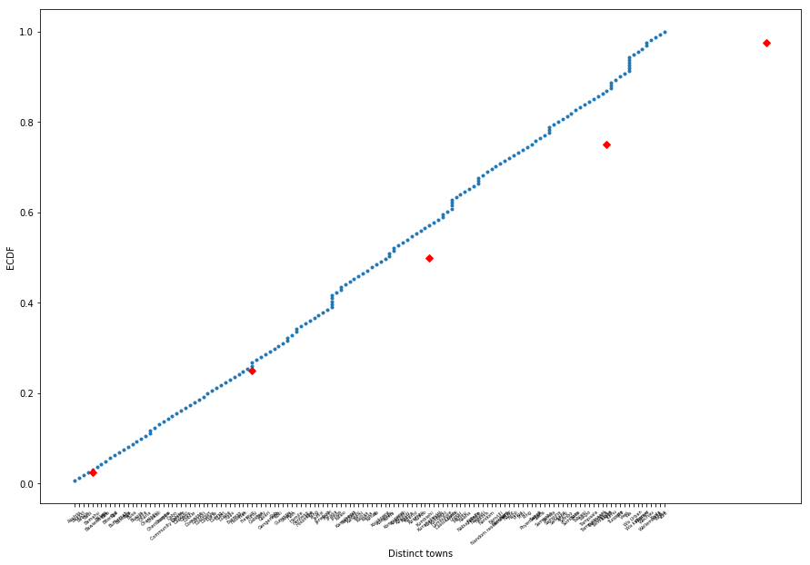
UPPER WEST REGION

Slide 23
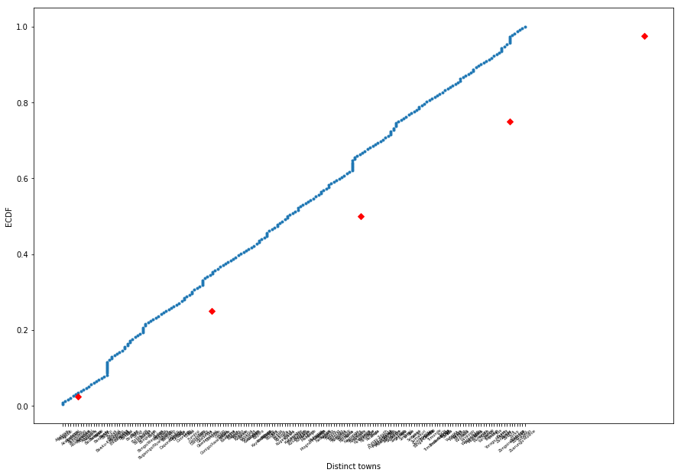
UPPER EAST REGION

Slide 24
DECISION RULE
Based on these findings, we can tell our client to allocate the health facilities at these four regions focusing more on the towns with one health facility.

Slide 25
Recommendation
We recommend that before embarking on the project, the population data of that particular town should be taken into consideration to help know the type of health facility to put up.
Also the standard of living and the economic life of the town folk should be critically paid attention to know whether it’s going to be owned by the government or by the private or a shared ownership.

